Slide 1
PROJECT RAPTORS REBOUND
DAT 205 Capstone Interim Progress
Group 1 - Bhavika Patil, Cindy Guo, Dennis Hung
Notes:
Good evening Everyone,
Today we are going to present our Interim Progress Report
Our group consists of [Pick an order “Bhavika, Cindy, Dennis”] and myself.
[NEXT SLIDE]

Slide 2
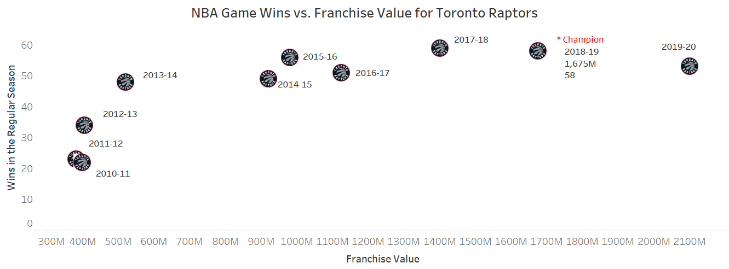
The Organization
The Toronto Raptors are an NBA championship team with a $2.1 billion market capitalization in 2020.
The team’s General Manager (GM) and owners are seeking recommendations on improving the team’s chances at another championship run while preserving the team’s long-term future.
Notes:
[NEXT 01 – Raptors]
The Toronto Raptors are an NBA championship team with a $2.1 billion market capitalization. Key players added in 2019 contributed to critical wins during the season and championship playoff run. The team has been in decline since being crowned 2019 NBA champions.
[NEXT 02 – GM]
The team’s General Manager (GM) and owners are seeking recommendations on improving the team’s chances at another championship run while preserving the team’s long-term future. The recommendations will be in the form of marginal/minor improvements to the player roster. The stakeholders intend to either maintain or improve on the number of wins during the regular season and more importantly during the playoffs.
The organization wants to retain a public interest in the team while improving the team’s performance without rebuilding the entire team. A spot in the NBA finals while maintaining the number of regular-season wins would be ideal.
[NEXT SLIDE]

Slide 3
Objectives
The primary objective of this analysis is to determine which features are important to the Toronto Raptors team to produce more wins in the regular season and the playoffs.
The secondary objective is to review team players’ performance-to-cost effectiveness.
Focus on the historical player data from 2005 to 2020 as this closely represent the players of the current era
Notes:
To attain the requirements outlined by the management, we are looking to determine what features affect team wins/losses and predict how this can be improved/reduced through changes in the team’s roster.
[NEXT 01 – Primary Objective]
The primary objective of this analysis is to determine which features are important to the Toronto Raptors team to produce more wins in the regular season and the playoffs.
[NEXT 02 - Secondary Objective]
The secondary objective is to review team players’ performance-to-cost effectiveness.
[NEXT 03 – Data scop]
The scope of this analysis will be to focus on the historical player data from 2005 to 2020 as this closely represent the players of the current era. The performance baseline of the team and players will be established using the data for The Toronto Raptors 2019-2020 season. These statistics will be used to indicate performance features for the team and the individual players.
[NEXT SLIDE]

Slide 4
Methods for Data collection
Open access API (nba_api)
PlayerGameLogs End point
Parameters required – Season, Season type
Total 465065 records, 36 features
Data Pull time : 1 hour???
PlayByPlay End point
Parameters required – GameId
Total ~10M records, 13 features
Data Pull time : 28 hours
NBA Player Salaries - National Basketball Association – ESPN
Player Salary data
Gathered by web scraping (Beautiful Soup Python Package)
Notes:
The data for this analysis is hosted by nba.com; It is made available via webservices through stats.nba.com.
[NEXT 01 – API]
nba_api is an open access API client library for Python developed by Swar Patel. There are more than 250 endpoints (the method to request information through the API) available.
[NEXT 02 – Player stats table]
We use playergamelogs to pull out player statistics by game as see in the table
[NEXT 03 – Player salaries]
We pulled player salary data from various sites and
[NEXT 04 – Player salaries table]
merged it together to produce a salary dataset.
[NEXT 05 – Player salaries historical]
both historical contracts from ESPN and
[NEXT 06 – Player salaries current]
current contracts
[Just pause for a couple of seconds]
[NEXT SLIDE]

Slide 5
Data (con’d)
Bhavika will dance here.
Notes:
[NEXT 0x – key statement for animation]
[Speaker’s talking points on the current slide item]
[NEXT SLIDE]

Slide 6
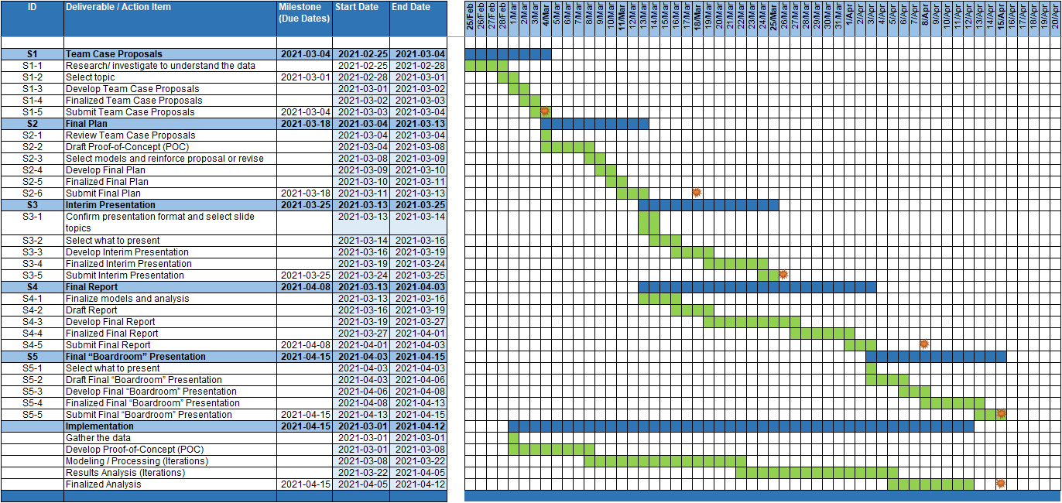
Project Planning
Notes:
[notes ] talk about roles and the challenges and expand on
PM
Data Architect
Program Mgr
Working as a team
Familiary with the domain.
The overall implementation will be in 5 phases with a deliverable provided at the end of each phase. Completion of the final report is targeted for Apr 15th along with a presentation to summarizing the recommendations outlined in the report.
[NEXT 0x – key statement for animation]
[Speaker’s talking points on the current slide item]
[NEXT SLIDE]

Slide 7
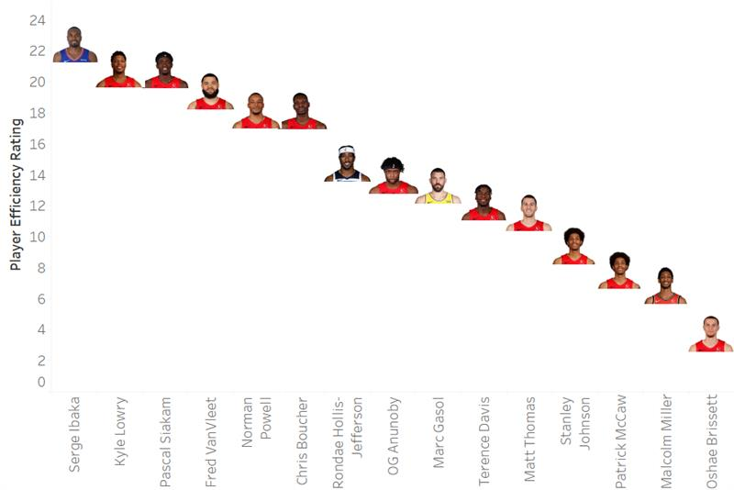
Initial Analysis
Cindy initial analysis
Notes:
Cindy explain chart and show formula and how data was obtained
[NEXT 0x – key statement for animation]
[Speaker’s talking points on the current slide item]
[NEXT SLIDE]

Slide 8
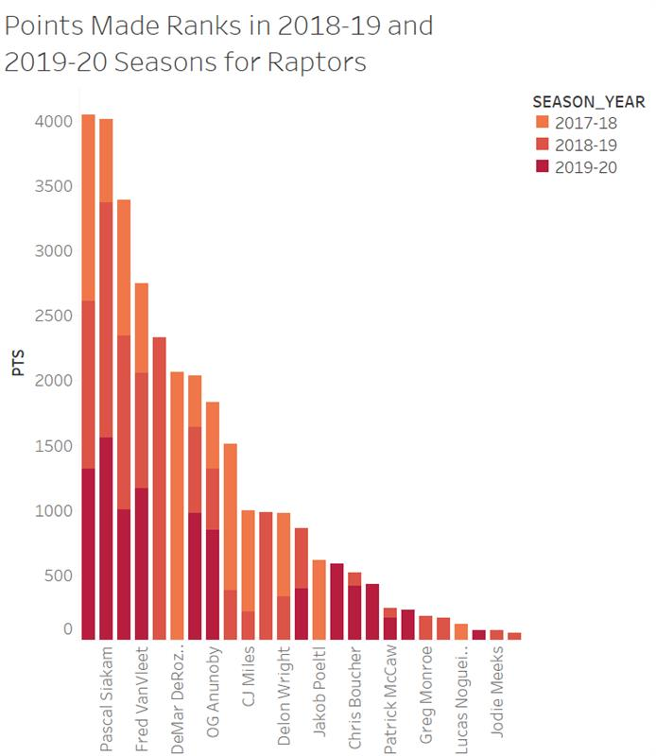
Initial Analysis
Text goes here
Notes:
[NEXT 0x – key statement for animation]
[Speaker’s talking points on the current slide item]
[NEXT SLIDE]

Slide 9
Preliminary Results
Result before fine-tuning
Ratings of the models
Important Features (top 5) (+/- Lucky bastard effect)
Notes:
[NEXT 0x – key statement for animation]
[Speaker’s talking points on the current slide item]
[NEXT SLIDE]

Slide 10
Preliminary Recommendations
Text goes here
Notes:
[NEXT 0x – key statement for animation]
[Speaker’s talking points on the current slide item]
[NEXT SLIDE]

Slide 11
[Template - Insert Title]
Notes:
[name to take over,]
Thank you, [Insert name]. Hello all, this is [Insert name]. I will continue to talk about [Insert next subject].
Thank you [Insert name]. I will continue on to the next part of [Insert next subject].
[NEXT 0x – key statement for animation]
[Speaker’s talking points on the current slide item]
[Next speak handoff statement]
Now I shall hand off to [Insert name]
[NEXT SLIDE]

Slide 12
Assumptions
01
Toronto Raptors only Play for NBA
02
The stats of games before 2005 are irreverent for current performers
Notes:
[NEXT 0x – key statement for animation]
[Speaker’s talking points on the current slide item]
[NEXT SLIDE]

Slide 13

THANK YOU
Notes:
This concludes our interim progress presentation.
Are there any questions?
Are there any ideas or suggestions?

